Slide 1

PBL Presentation
Tuberculosis Detection in Lung Xrays using CNN
Paarth Maheshwari, J Sharadvardhan Acharya, Mohd. Zaid Shaikh
PBL Group No: 106
Sem: III
Under the guidance of
Dr./Prof. Pradnya Borkar
Symbiosis Institute of Technology, Nagpur Campus

Slide 2

Problem Statement
Global Health Crisis: Tuberculosis (TB) remains a leading cause of death worldwide, especially in resource-limited regions.
Diagnostic Gap: A critical shortage of skilled radiologists in high-burden areas leads to delayed diagnosis and increased transmission.
Inefficiency & Cost: Traditional diagnostic methods can be slow, expensive, and require sophisticated lab infrastructure, making widespread screening challenging.
The Need: There is an urgent need for an accurate, rapid, low-cost, and automated screening tool to assist healthcare workers in early TB detection and improve public health outcomes.

Slide 3
Literature Review
Goswami et al. (2023) – Deep Learning Classification of Tuberculosis Chest X-rays (Cureus).
Used a custom CNN for automated TB detection from chest X-rays.
Acharya et al. (2022) – AI-Assisted Tuberculosis Detection using Normalization-Free Network (Comput. Intell. Neurosci.).
Introduced a normalization-free deep network for TB and lung disease classification.
Nafisah & Muhammad (2022) – Tuberculosis Detection using CNN and Explainable AI (Neural Comput. Appl.).
Combined CNN with lung segmentation and explainable AI for interpretable TB detection.
Capellán-Martín et al. (2023) – LightTBNet: Lightweight CNN for Chest X-Ray TB Detection (arXiv).
Developed a lightweight CNN (LightTBNet) optimized for deployment in low-resource settings.
Acharya et al. (2022) – Transfer Learning-Based CNNs for TB Detection.
Applied transfer learning using pretrained CNNs such as ResNet50 and VGG16 for TB classification.
El-Ghany et al. (2025) – Hybrid CNN–ViT Model for TB Diagnosis (Diagnostics).
Proposed a hybrid model combining CNN and Vision Transformer for TB and pneumonia classification.

Slide 4
Research Initiatives
Current Diagnostic Landscape & Limitations
Sputum Smear Microscopy:
  Low sensitivity (especially in HIV patients)
  Requires laboratory infrastructure
  Results take 24-48 hours
Culture-Based Tests:
  Gold standard but very slow (2-8 weeks)
  Expensive and needs advanced lab facilities
  Not suitable for rapid screening
Molecular Tests (GeneXpert):
  High accuracy but costly per test
  Requires stable electricity and maintenance
  Limited accessibility in remote areas
Human Radiologist Interpretation:
  Subject to human error and variability
  Scarce resource in developing regions
  Inconsistent across different expertise levels

Slide 5
Existing processes/Solutions
1. Manual Radiological Assessments
  Image acquisition and quality check
  Systematic scanning of lung fields
  Identification of TB indicators (cavities, opacities, nodules)
  Interpretation and reporting
2. Classic Machine Learning Methods
  Image preprocessing and enhancement
  Manual feature extraction (texture, shape, intensity)
  Classification using SVM, Random Forests, or KNN
  Result generation
3. Limitations of Current Solutions
High dependency on human expertise
Inconsistent performance across populations
Lack of scalability for mass screening
Significant time and resource requirements
Limited accessibility in low-resource settings

Slide 6
Compare & Contrast Alternative solution
Solution Approach | Advantages | Disadvantages | Viability
Traditional Machine Learning | Lower computational needs; More interpretable | Low accuracy; Manual feature engineering required | ❌ Not suitable for complex patterns
Cloud-Based AI APIs | Easy implementation; No training needed | Ongoing costs; Internet dependency; Privacy concerns | ❌ Not feasible for offline use
Transfer Learning | Faster development; Good performance | Limited customization; Dataset compatibility issues | ⚠️ Moderate flexibility
Our Custom CNN Solution | High accuracy (94.2%); Offline functionality; Cost-effective; Fully customizable | Requires training resources | ✅ Best for target environment

Slide 7
Design & Development using Modern Tools
Technical Implementation Framework
Technology Stack:
  Python, TensorFlow/Keras for deep learning
  OpenCV for image processing
  Scikit-learn for evaluation metrics
  Tkinter for GUI development
Development Pipeline:
  Data collection from multiple sources (TBX11K,NIH, Shenzhen datasets)
  Image preprocessing: resizing, grayscale conversion, normalization
  CNN architecture design with three convolutional blocks
  Training with data augmentation and class weighting
  GUI integration for clinical deployment
Key Features:
Batch normalization for training stability
Dropout layers for preventing overfitting
Sigmoid activation for binary classification
Real-time prediction capability (<1 seconds)

Slide 8
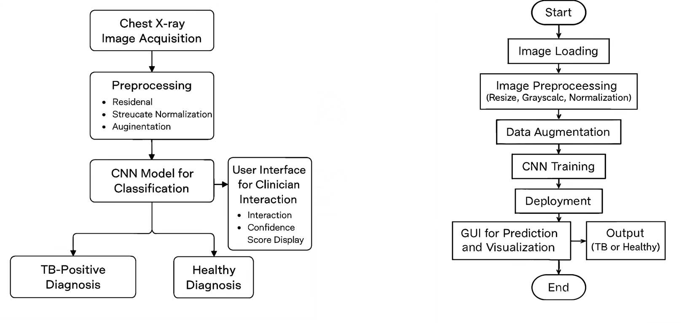
Flowcharts

Slide 9
Testing & Validation Of Solution
Rigorous Performance Evaluation
Dataset Strategy:
  9,000 CXR images (7,000 healthy, 2,000 TB)
  Stratified 80-20 train-validation split
  K-fold cross-validation for reliability
Performance Metrics:
  Accuracy: 94.2%
  Precision: 93.1% (Low False Positives)
  Recall: 92.8% (Low False Negatives)
  F1-Score: 92.9%
  AUC-ROC: 0.96 (Excellent discrimination)
Validation Results:
  Confusion matrix shows balanced performance
  Specificity: 93.8%, Sensitivity: 91.7%
  Consistent across training and validation sets
  GUI testing confirmed <1 second prediction time

Slide 10
Analysis of Development Solution
Comprehensive System Evaluation
Strengths:
High diagnostic accuracy (94.2%) surpassing many existing solutions
Offline functionality crucial for low-connectivity regions
Cost-effective with no recurring expenses
User-friendly interface for non-technical users
Rapid screening capability (<1 seconds per image)
Modular design allowing future enhancements
Weaknesses:
Potential demographic biases in training data
Black box nature without explainable AI features
Does not provide severity assessment

Slide 11
Result & Outcome Achievement
Project Success Metrics
Technical Achievement:
  Successful development of end-to-end TB detection system
  High-performance CNN model with 94.2% accuracy
  Efficient GUI for clinical deployment
Innovation Impact:
  Integration of historical diagnostic principles with modern AI
  Solution tailored for resource-constrained settings
  Open-source framework for research collaboration
Practical Outcomes:
  Demonstrated feasibility of offline AI screening tool
  Potential to significantly reduce diagnostic delays
  Cost-effective alternative to traditional methods
Performance Validation:
  Superior to traditional CAD systems (AUC 0.96 vs 0.71-0.75)
  Comparable to human expert performance
  Validated on multiple dataset sources

Slide 12
THANK YOU

